Slide 1
Student Fee Payment Using PayPal
Scrum master:
Soney benny Thomas
Members:
Adithya chandran
Jerin p r
Martina Graceson Cherian
Vidya vasu

Slide 2
INTRODUCTION
Project is entitled Student fee payment
Front end is Android Studio
Back end is MySQL
Basically the project is about providing the students a platform to pay their fees online without having to wait in long queues.
PayPal platform is used for payment purpose

Slide 3
System Requirements
Android Studio latest version
Wamp Server
MySQL Database
PayPal SDK
PayPal account

Slide 4
Modules
There are two modules:
Admin: The Admin has to login to the application and should be able to add and view student details.
Student: The student has to login to the application and should be able to view their profile and pay their fees using PayPal.

Slide 5
Functionalities
The Admin has the functions of adding student records in database.
The Admin provides the student, the registration Id, which is the username, and password to the students.
The students using the username and password, login to the application.
The students can then be able to view their profile, and pay their fees.
The student has to login to the Paypal account and then pay their fees using this gateway.

Slide 6
Future Plan
In future the admin would be able to view the payment transaction history of each student.
The admin would be able to provide fee details to the students and update the dues of students accordingly.
Admin would be able to update and delete student details from database.

Slide 7
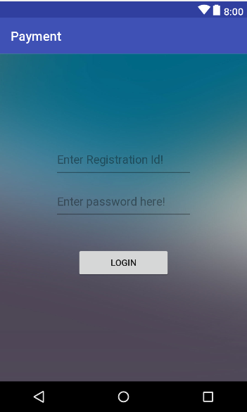
Screenshots
Admin and students can login using this Login Form

Slide 8
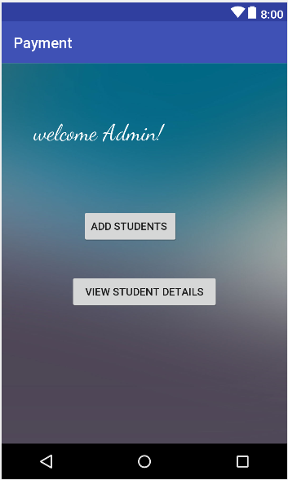
Screenshots
After logging in, the admin will be redirected to his home page.

Slide 9
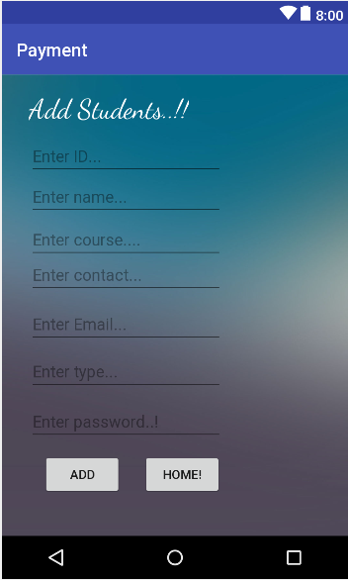
Screenshots
The Admin can add students using this form.
After logging in the students will be redirected to their respective home pages.

Slide 10
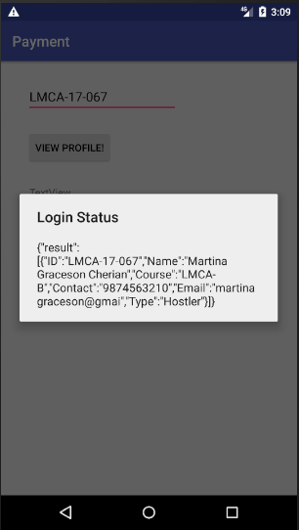
Screenshots
The Admin can view student details using this form.

Slide 11
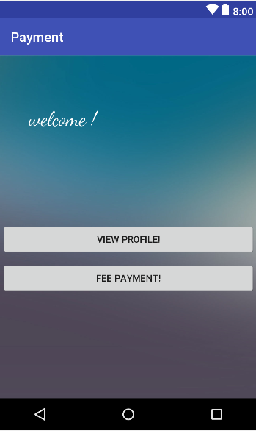
Screenshots
After logging in the students will be redirected to their respective home pages.

Slide 12
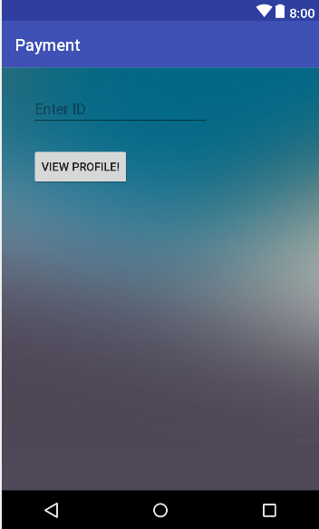
Screenshots
After logging in the students will be able to view their details through student profiles.

Slide 13
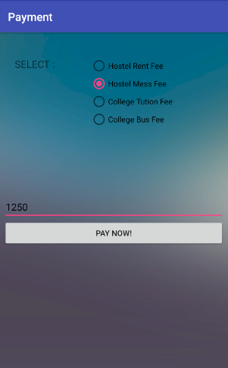
Screenshots
Students can enter the fee detail and the amount through this form. After entering the amount, they can submit it by clicking on the Pay Now button.

Slide 14
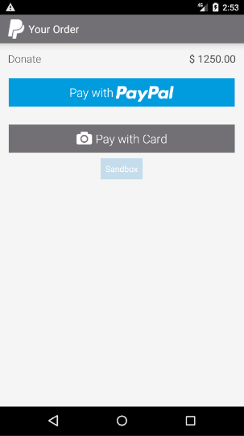
Screenshots
After submitting the control will go to the PayPal site

Slide 15
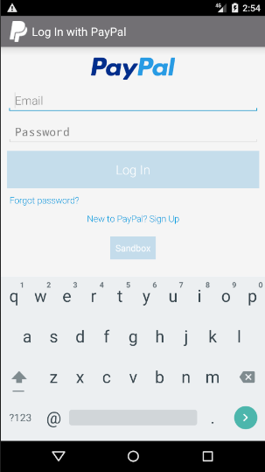
Screenshots
By pressing the Pay now option the login page will display!
The payment can be proceeded after logging into the valid PayPal account.

Slide 16
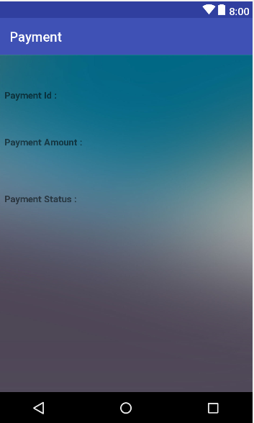
Screenshots
The payment details as Id, amount and status will be displayed.

Slide 17
Conclusion
Students now need not wait in long queues to pay their fees.
They can just login to their application using the registration number and password provided externally by the admin.
They can utilize the application and PayPal account to successfully pay their fees.
Minimizes time and effort.

